Slide 1
Big Data Analytics
By
Kavya Devarapally
Anvesh Muttavarapu

Slide 2
House Pricing
Goal:
To predict the final price of each home, given variables describing every aspect of residential homes.
Data Set :
Data set is available on http://kaggle.com.

Slide 3
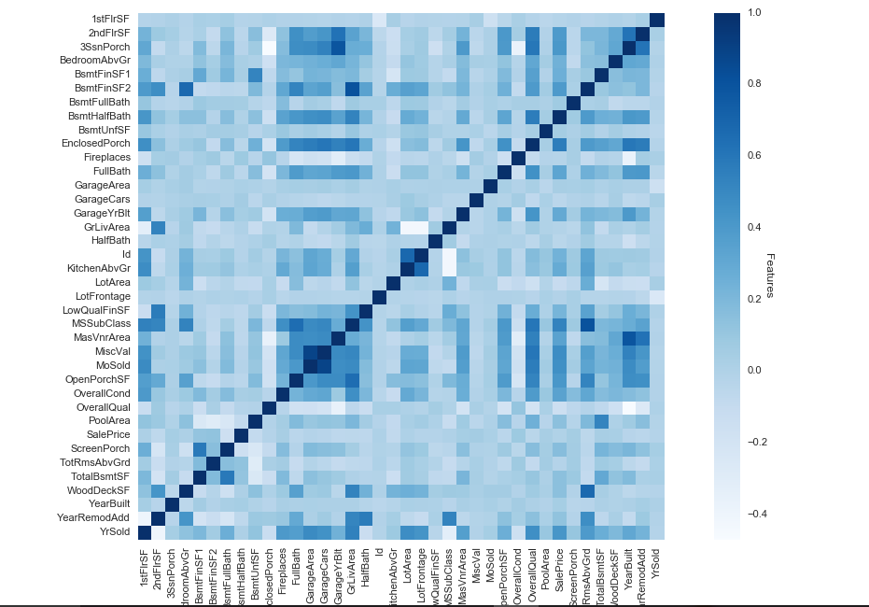
Correlation

Slide 4
Lasso Model
Used for Feature selection and regression estimation.
class sklearn.linear_model.Lasso(alpha = 1.0, it_intercept=True, normalize=False, precompute=False, copy_X=True, max_iter=1000, tol=0.0001, warm_start=False, positive=False, random_state=None, selection='cyclic)

Slide 5
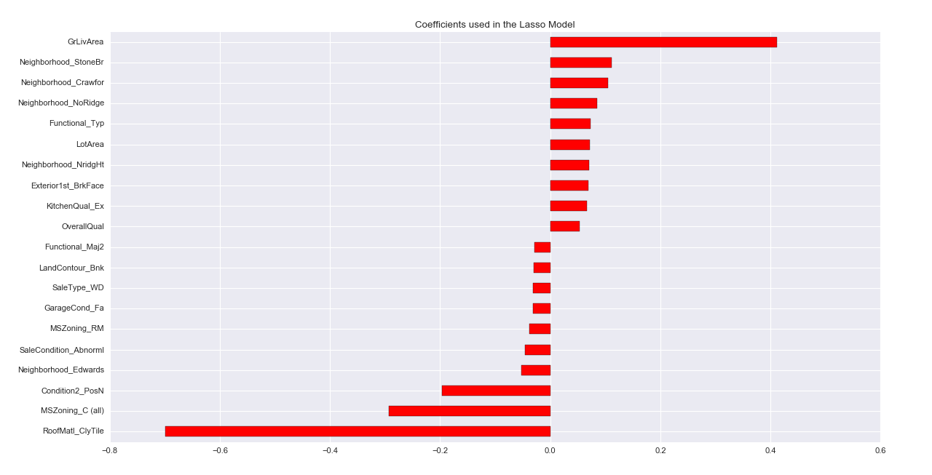
Features selected by Lasso

Slide 6
Lasso Model
Root mean Square error calculated:
rmse= np.sqrt(-cross_val_score(model, trainData, YData, scoring="neg_mean_squared_error", cv=5))
Rmse = 0.1229

Slide 7
Linear Regression
linear_regression = linear_regression.fit(trainData,YData)
Root mean Square error calculated for Linear Regression:
rmse= 0.1655

Slide 8
XGBoost
class xgboost.XGBRegressor(max_depth=3, learning_rate=0.1, n_estimators=100, silent=True, objective='reg:linear', nthread=-1, gamma=0, min_child_weight=1, max_delta_step=0, subsample=1, colsample_bytree=1, colsample_bylevel=1, reg_alpha=0, reg_lambda=1, scale_pos_weight=1, base_score=0.5, seed=0, missing=None)

Slide 9
XGBoost
Root mean square error calculated for XGBoost:
rmse = 0.119

Slide 10
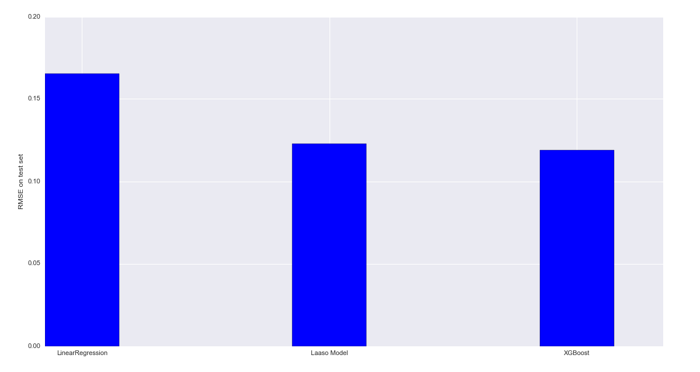
Comparing 3 Regression models

Slide 11
Conclusion
When comparing three models, Xgboost regression model works better followed by Lasso model and Linear regression model.

